Slide 1
Box Platform Developer Workshop
Jonathan LeBlanc
Director of Developer Advocacy, Box
Twitter: @jcleblanc
Github: https://github.com/jcleblanc

Slide 2
Advanced Automation and Machine Learning

Slide 3
Skills

Slide 4


Foundational Skills
Custom Skills
Turned on manually through
Box site account. Provides enhancements for images,
video, audio, etc.
Extends upon the platform event pump / webhook system to hook to machine learning system with the intent of enhancing file metadata.

Slide 5
Custom Skills

Slide 6
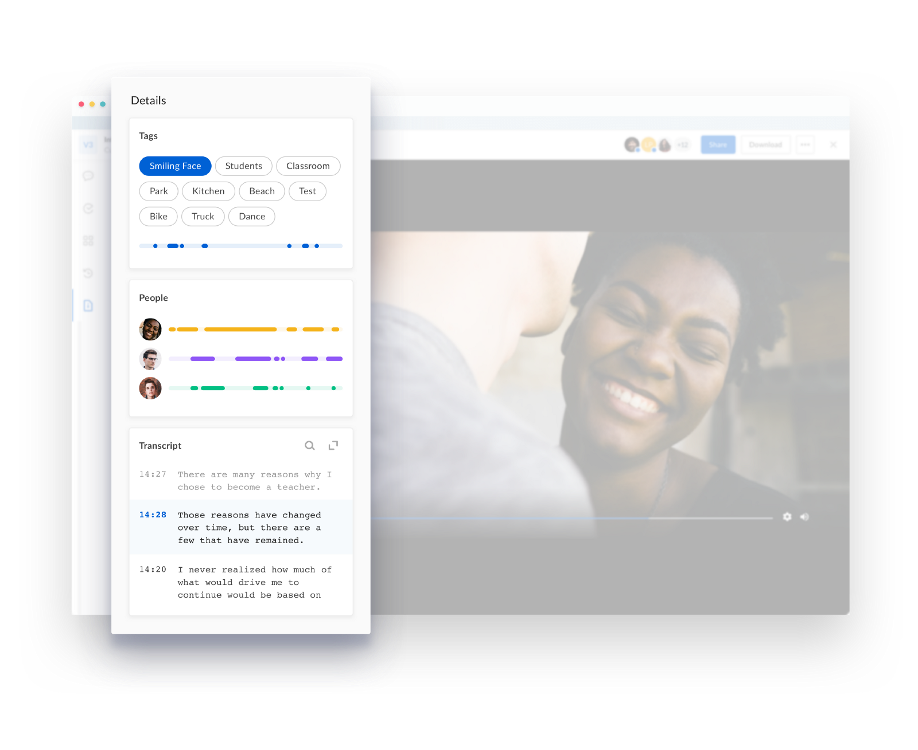
Custom Skills
Allows for the enhancement of file metadata automatically through machine learning services.
Provides multiple card types for displaying data (timeline, transcript, keyword).
Uses tightly scoped read / write downscoped tokens.

Slide 7
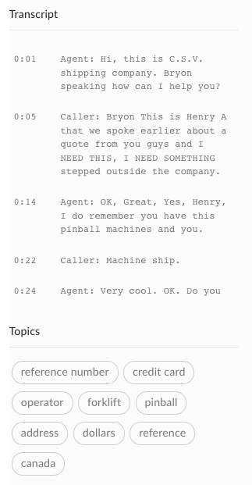
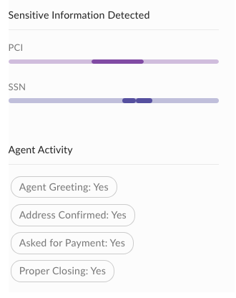
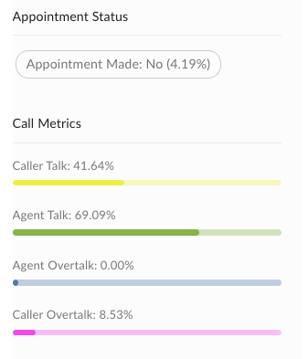
Example Skills Metadata Enhancement (Audio Data)

Slide 8
Skills Workflow
Event
Execute
Metadata
Callback
File Upload
Middleware
Machine Learning
The skills process is triggered when a new or updated file is uploaded to Box. An event is sent to a specified endpoint with file access information.
The middleware layer works as an intermediary between the Box file and ML system. It sends the file info the the ML system and updates the Box file metadata with its response.
The machine learning system will take in the contents of a Box file, run analysis of the data, and respond with the enhanced metadata to the middleware layer.

Slide 9
Sample Application

